Slide 1

A Hands-on Introduction to Machine Learning
8. Dimensionality Reduction

Slide 2
The curse of dimensionality
Curse of dimensionality = unexpected errors or difficulties that happen as the number of features increases
Dimensionality reduction is a method of converting high dimensional spaces into lower dimensional spaces without losing the major information of the variables

Slide 3
Methods for dimensionality reduction
Feature selection
Principal Components Analysis (PCA)
Linear Discriminant Analysis (LDA)

Slide 4
Feature selection
Removing redundant or unnecessary features can help reduce model complexity and provide more robust learning
Methods:
Removing features with low variance
Univariate feature selection
Feature importance

Slide 5
Principle Component Analysis (PCA)
Reduces features by projecting the data into a lower-dimensional subspace
To compress the data with minimal information loss, PCA transforms original covariate dataset variables into the independent factors with the most variability
These independent factors are called principal components, which provide the most discriminative features of the original data

Slide 6
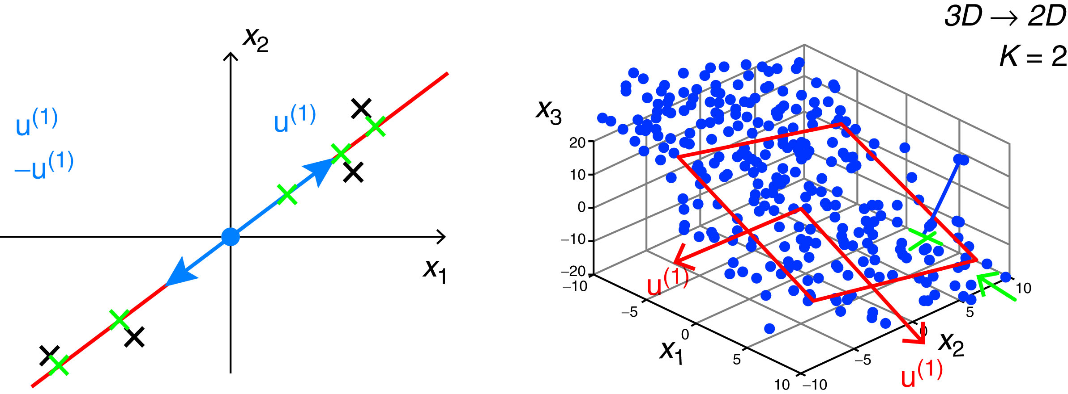
PCA example
Principal Component Analysis (PCA) problem formulation

Slide 7
Linear Discriminant Analysis (LDA)
Projects an n-dimensional dataset into a k-dimensional subspace where k<n, while maintaining maximum variance between classes
Traditionally used as a linear machine learning algorithm for multiclass classification, but the resulting linear combination can also be used for dimensionality reduction
Seeks to find a linear projection of the input variables that achieves the maximum separation between classes and minimum separation within data points of each class

Slide 8
Summary
Curse of dimensionality – a large number of features could lead to unexpected errors or issues.
Reducing number of features to a lower number = dimensionality reduction
Different techniques with different objectives:
Feature selection
Principal Components Analysis (PCA)
Linear Discriminant Analysis (LDA)

